Slide 1
Exploring the Effect of Alcohol Establishments on Crime in an Urban Community
T. LaFrance, June 2020
Capstone Final Project, IBM Data Analysis Course

Slide 2
Introduction
To be explored in this analysis is the location of alcohol related establishments and the local area crimes.
The distribution of businesses that are primarily related to alcohol, such as bars, nightclubs and retail alcoholic beverage markets should be understood.
The proximity, frequency and type of crime is the information to be overlaid and evaluated with respect to the business locations.
This information would assist in community development and resource planning for local police and authorities

Slide 3
Data availability and sources
The location data for venues is achievable through Foursquare with some data filtering and processing needed
The data for relevant crimes could be found in several datasets at state and county level but required lots of previewing in order to select a dataset that had the correct information. One complication is that crimes related to driving under the influence are referred to as DUI, DWI, OVI, OWI.
Sources of information that were helpful include the CDC website, FBI crimes website and crash tests website as noted below;
https://www.cdc.gov/motorvehiclesafety/impaired_driving/impaired-drv_factsheet.html
https://ucr.fbi.gov/crime-in-the-u.s/2016/crime-in-the-u.s.-2016/tables/table-18
https://crashstats.nhtsa.dot.gov/Api/Public/ViewPublication/812450

Slide 4
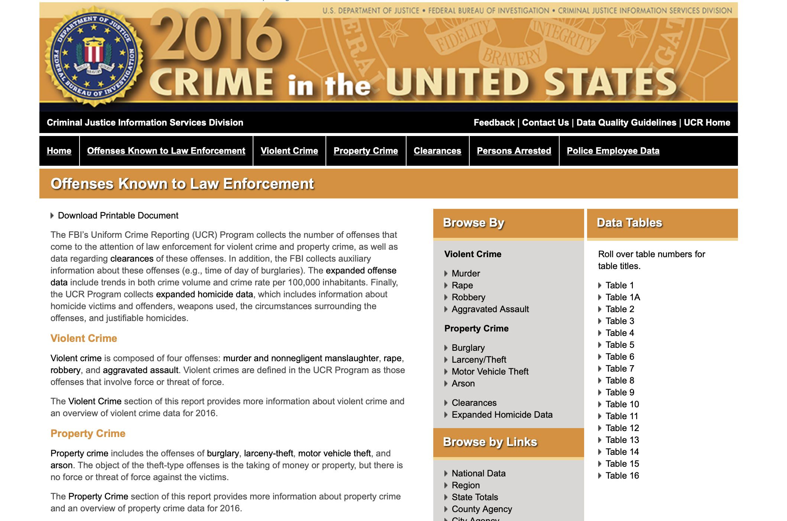
Sample of Data Sources

Slide 5
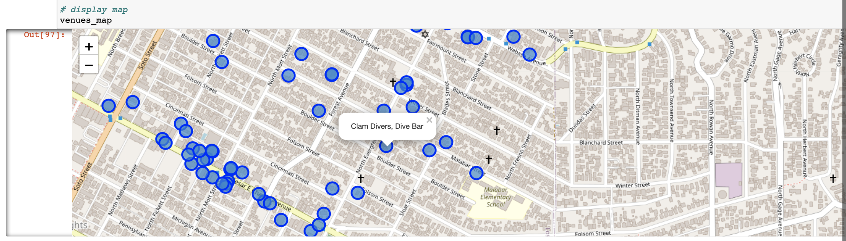
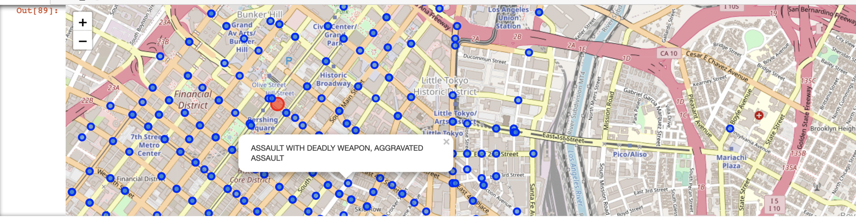
Results
Map of Venues in Los Angeles downtown area
Map of Crimes in Los Angeles downtown area

Slide 6
Conclusion
The visualizations do not identify any trends that that suggest a relationship between alcohol establishments and crimes in downtown Los Angeles
It is possible that the sheer number of crimes occurring on every block in Los Angeles obscures trends or observation of at risk areas
For further study on this subject, selecting alcohol specific crimes may produce different results as well as comparing a city with a large number of alcoholic venues with a city with fewer alcoholic venues

